Slide 1
Tender Notice extraction from E-papers using Neural Network
Anuj Sedhai | THA075BCT010
Ashmin Bhattarai | THA075BCT012
Devraj Neupane | THA075BCT019
Manish Khadka | THA075BCT025
Department of Electronics and Computer Engineering Institute of Engineering, Thapathali Campus

Slide 2
Presentation Outline
Motivation
Objectives
Scope of Project
Application of Project
Proposed Methodology
Working Principle
Expected Results
Tentative Timeline
Project Expenses
References

Slide 3
Motivation
Tender notices are published in national as well as local newspapers
Financial institutions need to collect a number of newspapers to find tender of their interest
Tender notices needed to be extracted in a single platform
Can be helpful in achieving efficiency as well as reducing the expenses.

Slide 4
Objectives
To extract tender notices from newspapers using neural network
To publish extracted notices

Slide 5
Scope of Project
Extract tender notices from the provided sources of e-papers
The tender notices may be in image or text format
Store the extracted notice in a database
Publication of the tender notice in a website

Slide 6
Application of Project
This project can be useful for big contractors and construction company
Government institutions can use this program to publish their tender notices

Slide 7
Methodology
Data Acquisition
Data Pre-processing
Models and Architecture Design
Training Models
Models Validation and Selection
Building a Webpage

Slide 8
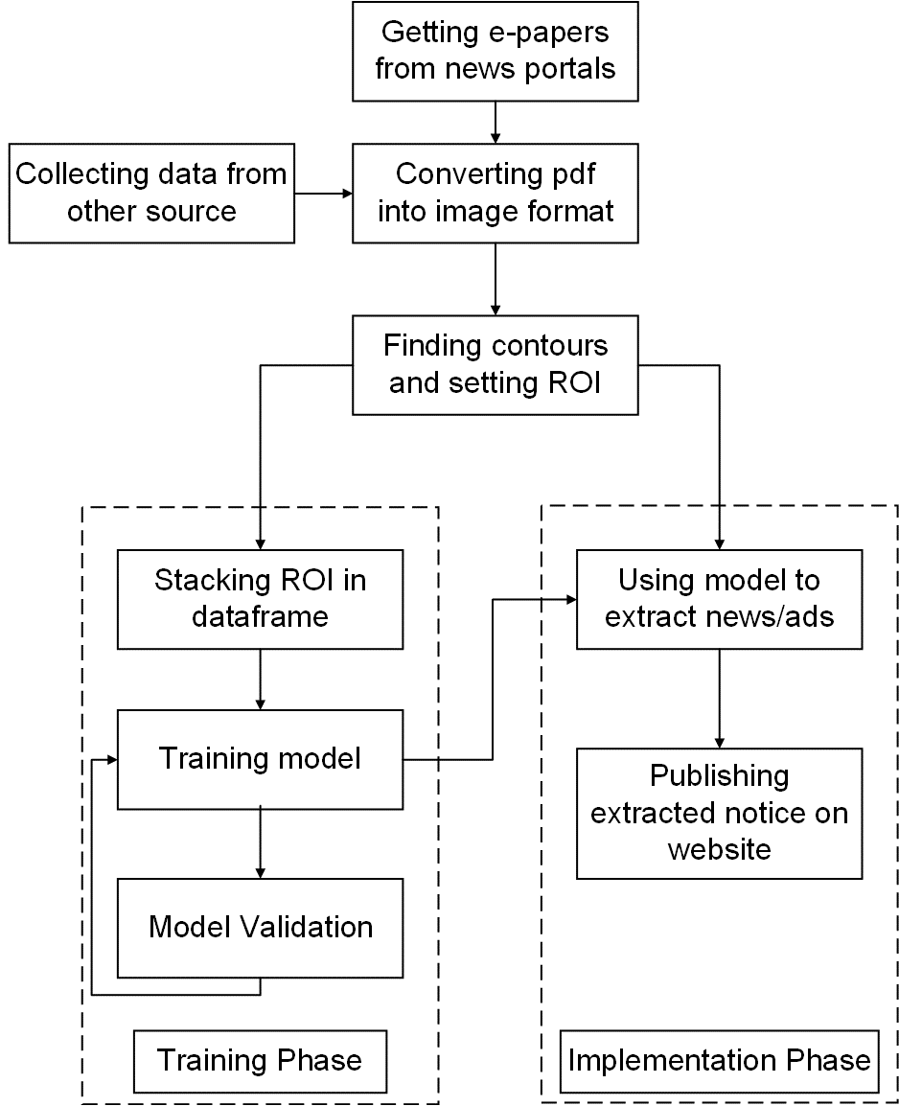
Proposed System

Slide 9
Working Principle
Data acquisition from e-papers
Date pre-processing
Model building
Model training, validation and selection
Model deployment

Slide 10
Data Pre-processing
Required for maintaining uniformity
Cropping and scaling images
Combining primary and secondary data sources
Leveling positive and negative images

Slide 11
Model Building
Different models will give different accuracy
Models that will be used while training
Support Vector Machine
GoogleNet Architecture of CNN
ResNet Architecture of CNN
Xception Architecture of CNN

Slide 12
Model Training Validation and Selection
All models mention before will be trained on our dataset
Graph of validation accuracy will be observed for all models
Model having highest accuracy will be chosen

Slide 13
Model Deployment
Tender notices will be extracted from e-papers using trained model
Extracted notices will be published on webpage

Slide 14
Data Sources
Primary Source
Manual data collection from Bolpatra Nepal
Secondary Source
Data collected from Google Image

Slide 15
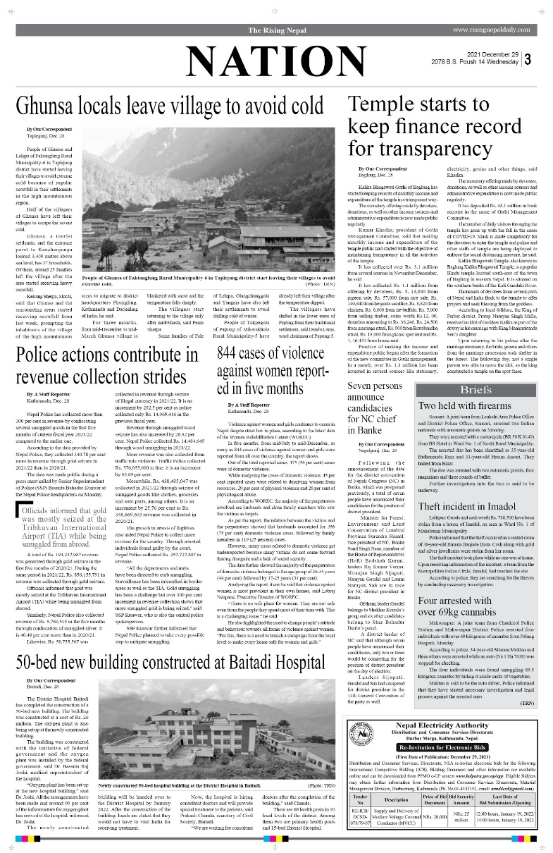
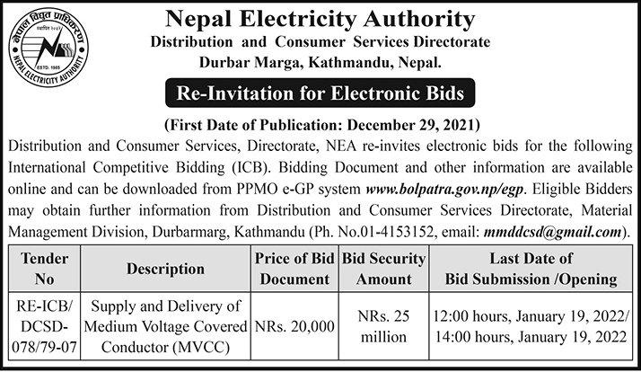
Expected Results

Slide 16
Contd.
E-papers will be scanned and tender notices are extracted
Extracted tender notices will be published in a webpage

Slide 17
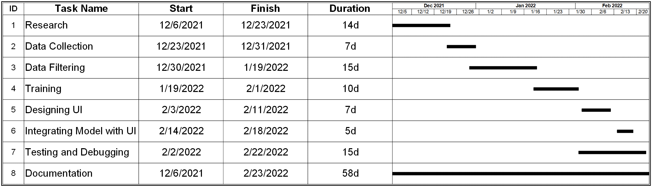
Tentative Timeline

Slide 18
Project Expenses
Have been granted approval to use datasets without any cost

Slide 19
References
Manuel J. García Rodríguez, Vicente Rodríguez Montequín, Francisco Ortega Fernández, Joaquín M. Villanueva Balsera, "Bidders Recommender for Public Procurement Auctions Using Machine Learning: Data Analysis, Algorithm, and Case Study with Tenders from Spain", Complexity, vol. 2020, Article ID 8858258, 20 pages, 2020.
Wei-Ta Chu and Han-Yuan Chang, "Advertisement Detection, Segmentation, and Classification for Newspaper Images and Website Snapshots," Proceedings of International Computer Symposium, 2016
Pooja Jain, et. al. “Convolutional Neural Network Based Advertisement Classification Models for Online English Newspapers.” (2021).

Slide 20
Kim, Sungyoung & Park, Soyoun & Kim, Minhwan. (2003). Central Object Extraction for Object-Based Image Retrieval. Image and Video Retrieval. 50. 523- 528. 10.1007/3-540-45113-7_5.
A.T. Vo, H.S. Tran and T.H. Le, "Advertisement image classification using convolutional neural network," 2017 9th International Conference on Knowledge and Systems Engineering (KSE), 2017, pp. 197-202, doi: 10.1109/KSE. 2017.8119458.
Vanderplas, J., 2016. Python Data Science Handbook. 1st ed. Sebastopol, CA: O'Reilly Media.
Géron, A., 2019. Hands-on machine learning with Scikit-Learn and TensorFlow. 2nd ed. Sebastopol, CA: O'Reilly

Slide 21
Thank You!

